Slide 1
Hi-Net: Hybrid-fusion Network for Multi-modal MR Image Synthesis
周越
IEEE TMI
2020/10/8

Slide 2
Contributions
•Different from most existing single-modality synthesis approaches, we present a novel medical image synthesis framework that uses multiple modalities to synthesize target modality images.
•Our model captures individual modality features through the modality-specific network, as well as exploits the correlations among multiple modalities using a layer-wise multi-modal fusion strategy to effectively integrate multi-modal multi-level representations.
•A novel MFB module is proposed to adaptively weight the different fusion strategies, effectively improving the fusion performance.

Slide 3
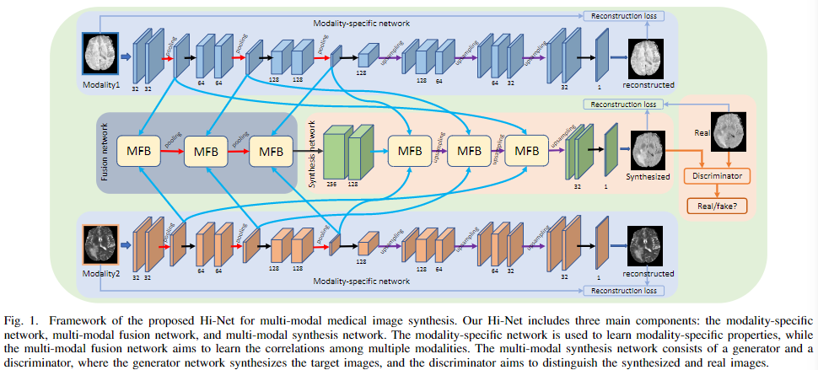
Framework

Slide 4

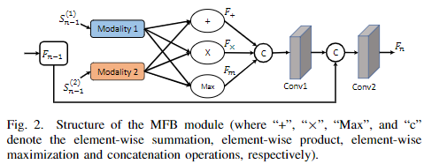
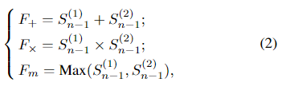
Mixed Fusion Block (MFB)
In the multi-modal fusion task, popular strategies include element-wise summation, element-wise product and element-wise maximization

Slide 5




Loss Function

Slide 6
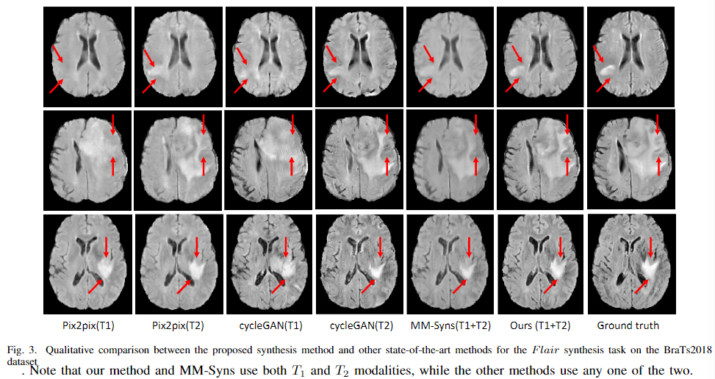
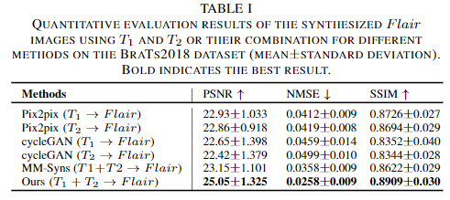
Experiments(T1+T2->Flair)

Slide 7
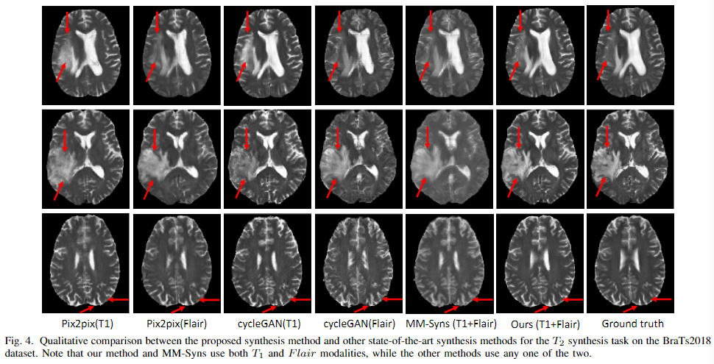
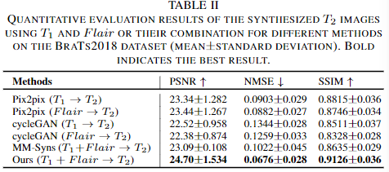
Experiments(T1+Flair->T2)

Slide 8
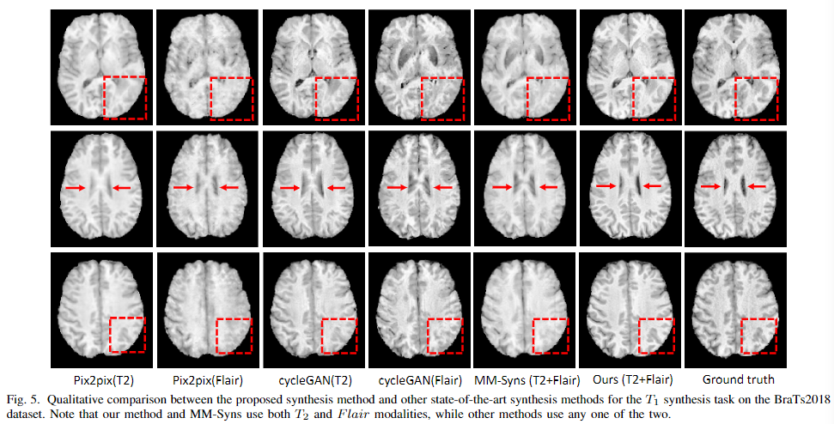
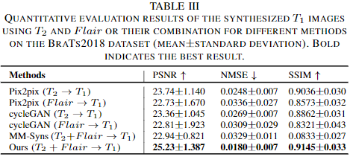
Experiments(T2+Flair->T1)

Slide 9
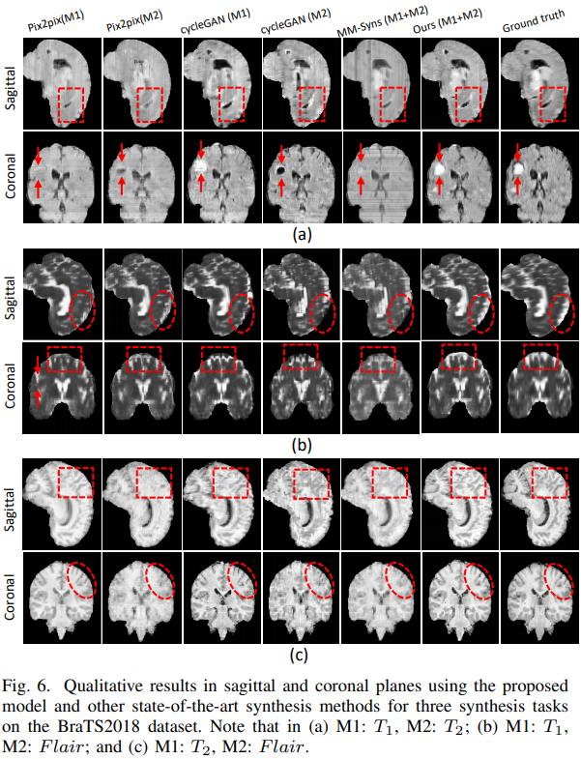
Experiments

Slide 10
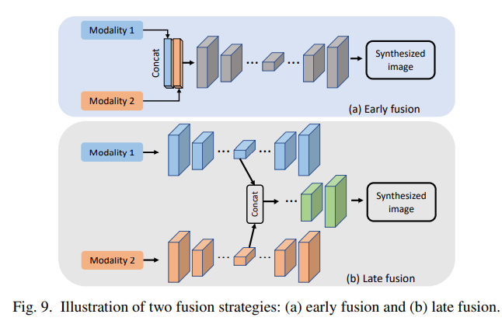
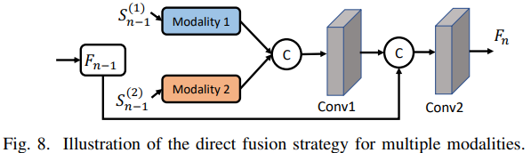
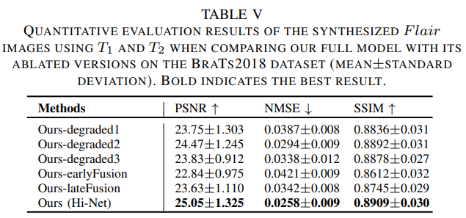
Ablation Study
Early fusion directly stacks all raw data and then feeds into a single deep network, while late fusion first extracts high-level features from each modality and then combines them using a concatenation layer

